Slide 1
Business Models & New Ventures
Tim Kastelle
3 May 2014
iLab Bootcamp

Slide 2
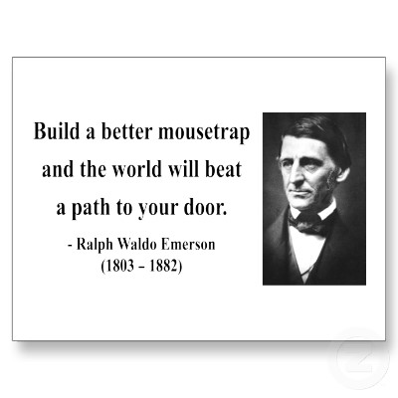

Slide 3
Mousetrap Patents
4400 mousetrap patents issued in the US alone since 1828
400 new applications per year
40 new patents granted per year
“The most frequently invented device in U.S. History.”
And yet, only a handful have made money

Slide 4
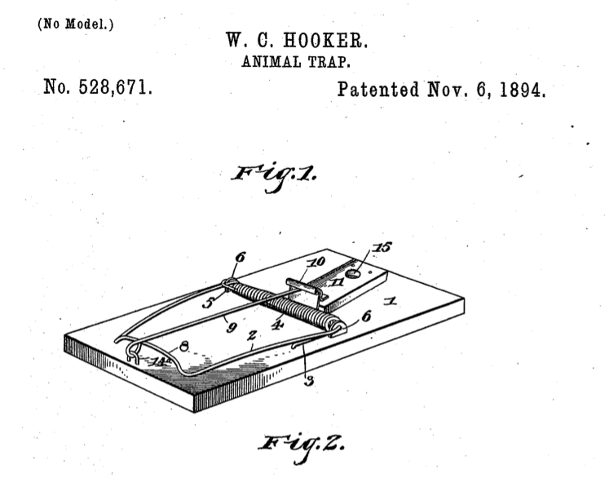
Mousetrap problem solved in 1894!

Slide 5

Or earlier….

Slide 6
Problem: Right now,
you have a better
mousetrap

Slide 7


Slide 8
You must solve a
real need

Slide 9
3 Paths to Disruptive Innovations

Slide 10
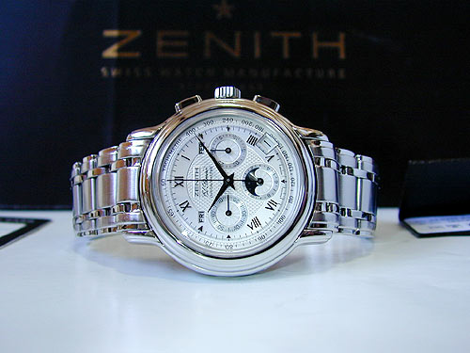

Slide 11
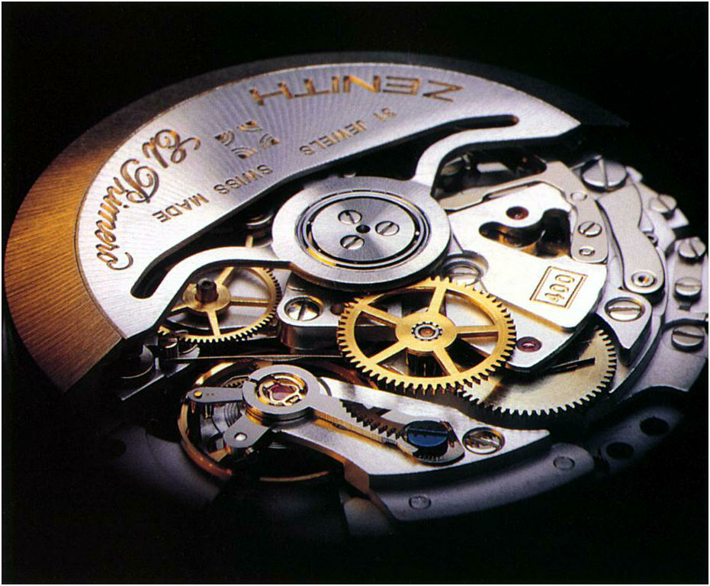

Slide 12
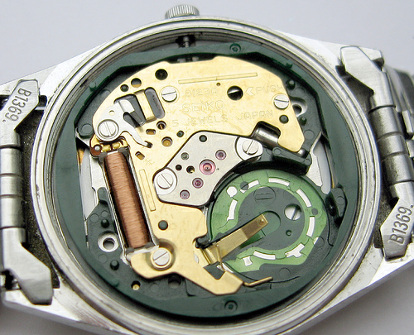

Slide 13
Path #1: Find a 10X Improvement
Quartz watches 10 times as accurate as the top of the line mechanical watches, for less than 1/10th of the cost
Question: what’s like quartz in your industry?

Slide 14

Why is the retirement age 65?

Slide 15
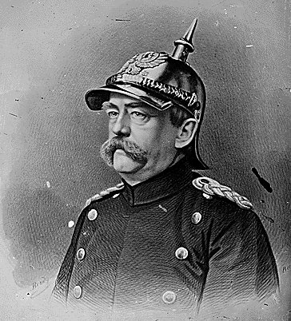

Slide 16
Life Expectancy
Germany 1880 – about 58 years (retirement age set at 65)
US 1935 – about 62 years (retirement age set at 65 too)
All the other countries that followed in the next decade <60 years

Slide 17
So…
What was the biggest innovation that drove this change in life expectancy?

Slide 18


Slide 19
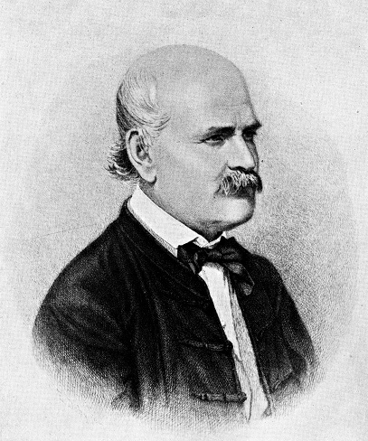

Slide 20
Medical Handwashing
First suggested – 1840s
First evidence that it works – 1850s
Germ theory of disease – 1860s
First use in surgery – 1870s
In widespread use – 1920s

Slide 21
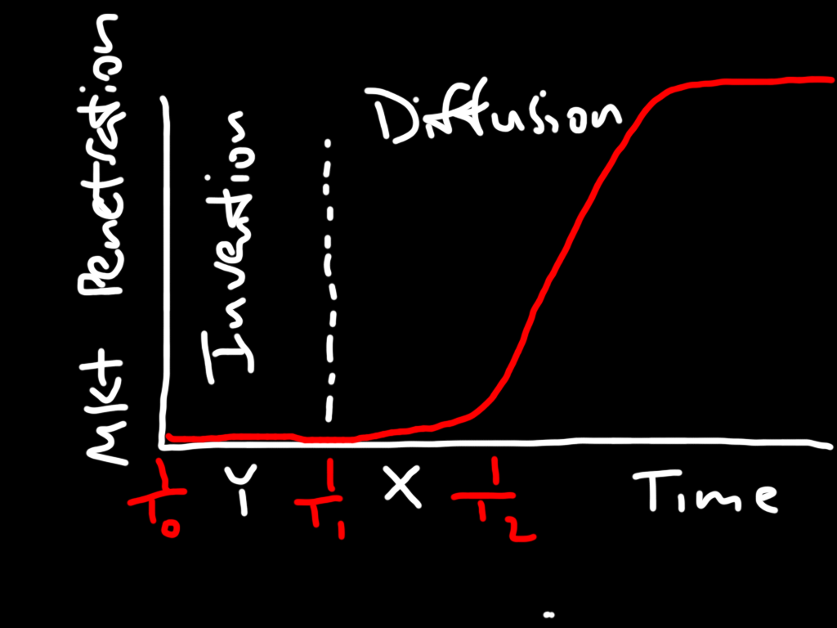

Slide 22
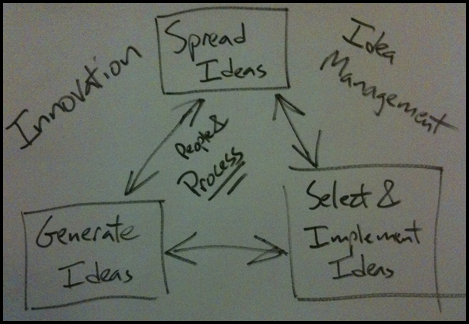

Slide 23
Ideas are often the
biggest innovations

Slide 24
Innovation always
changes behaviour

Slide 25
Path #2: Find a new idea
We focus too much on technological innovation – that’s only part of the story
Question: how could you reimagine your industry?

Slide 26
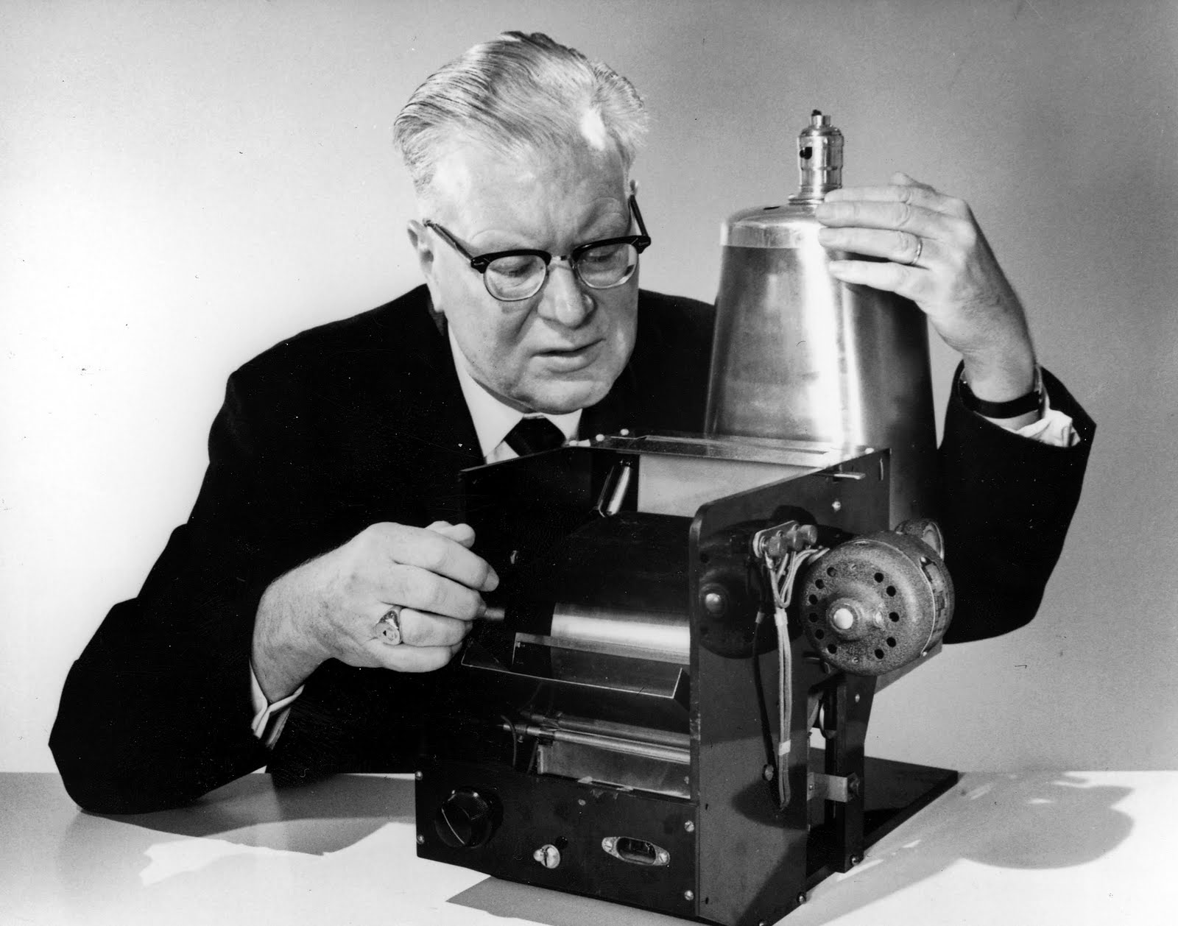
1936

Slide 27
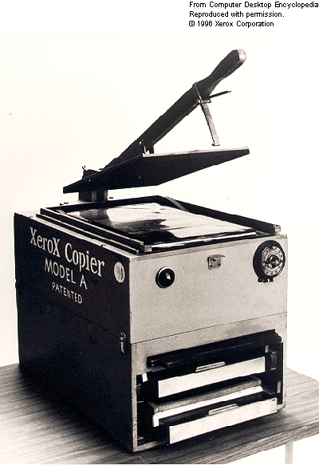
1950

Slide 28
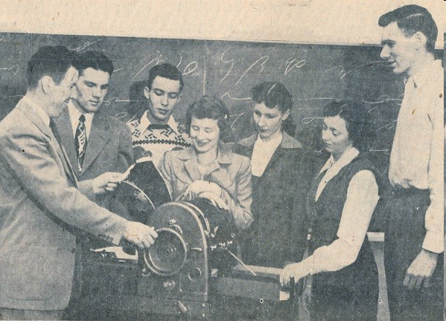

Slide 29
Business Model Innovations in Copying
1950s – copies made by mimeograph or dry thermal processes – very poor quality, hard to archive
Equipment was inexpensive, money was made on supplies
90% of machines made < 100 copies per month

Slide 30
The Arrival of Xerox
Invention of xerography – much higher quality, longer lasting (Chester Carlson files patent in 1937)
Haloid Corp licenses patent, sells first Xerox machine in 1950
Problem: Xerox machines six times more expensive than competitive technology, cost per copy about the same
Kodak, GE, IBM and Arthur D. Little Consultants all concluded there was no market for Xerox machines

Slide 31
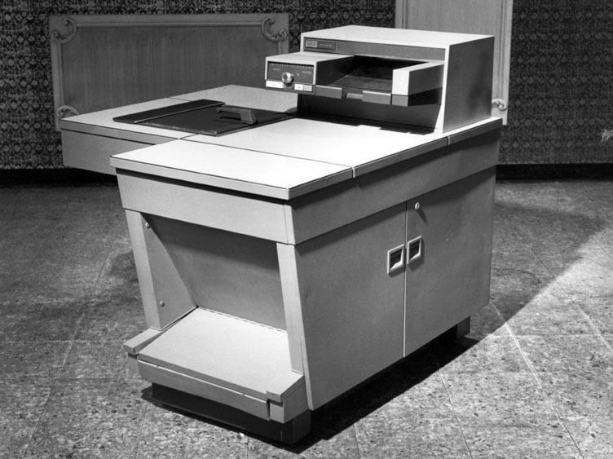
1959

Slide 32
The New Business Model
High volume users
Lease machines instead of selling them, includes 2000 copies per month, customers pay extra for all further copies
Improved quality and convenience led to average user making 2000 copies per day!
The more copies made, the more money Xerox makes

Slide 33
Dominant Logic of Xerox
More copies are better
New product innovations must lead to higher volume
Duplexing
Collating
Stapling
Copies per minute

Slide 34
The State of Play by the1970s
Xerox and Kodak dominate the market, selling nothing but high volume machines
Sales are made by internal sales force, service performed by internal service teams
Cost of equipment very high (no more leasing)
Small volume users either use older methods or go to copy centres

Slide 35
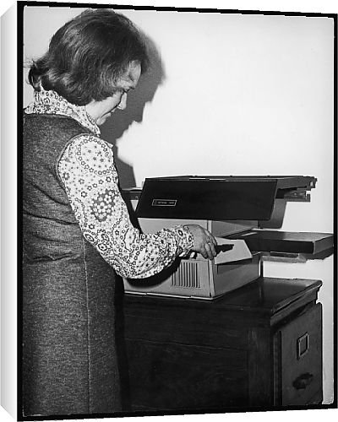

Slide 36
1950

Slide 37
Another New Business Model
Cheap copiers, no features
Very high cost per copy, mediocre technology
Copiers sold through office supply stores
Sales and service outsourced

Slide 38
Photocopier Market Shares

Slide 39
New Business Models for Disruptive Innovation
Choose a market segment whose needs are not being met
Focus on this segment, build competencies, increase skills
Use new competencies to expand into more profitable parts of the value chain or better market segments
Compete against large incumbents by changing the rules of the game

Slide 40
Path #3: Find a New Business Model
New business models start in niches (think: taxi drivers + Prius, or hydrogen-powered vehicles + bus fleets)
In terms of performance, they always look lousy at the start
Question: what would a new business model look like in your industry?

Slide 41
Three Paths to Discontinuous Innovation
Find a 10X improvement in performance.
Find a new idea.
Find a new business model.

Slide 42
More on Business Models

Slide 43
Definition
A business model articulates the logic and provides data and other evidence that demonstrates how a business creates and delivers value to customers.
David Teece, Long Range Planning

Slide 44
So What?
“While building a product is what you do best and where you derive the biggest sense of accomplishment, building a product is NOT “the product” of your startup. Your business model is “the product”.
Ash Maurya
Source: http://www.ashmaurya.com/2011/06/your-product-is-not-the-product/

Slide 45
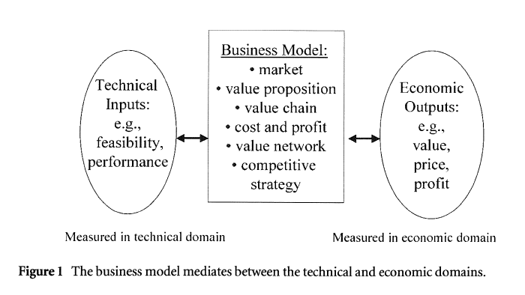
Business Model Innovation – Critical but Overlooked
Source: Open Innovation by Henry Chesbrough

Slide 46
Source: Alex Osterwalder, www.businessmodelgeneration.com

Slide 47
Why Business Models Are Important
They tell you if your overall approach is coherent
Innovating the business model of an industry is the most effective way to enter it (usually easier to find than a 10X improvement)
Products can be copied more easily than a new business model can

Slide 48
the
BUSINESS MODEL
CANVAS

Slide 49
9
building blocks

Slide 50
the 9 building blocks of a business model
images by JAM

Slide 51
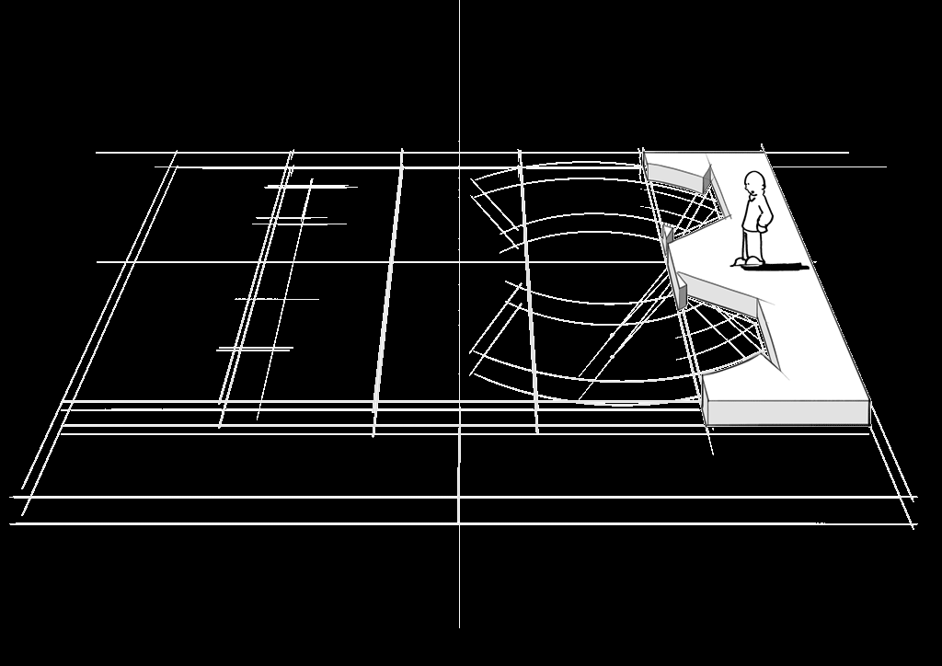
CUSTOMER SEGMENTS
images by JAM

Slide 52
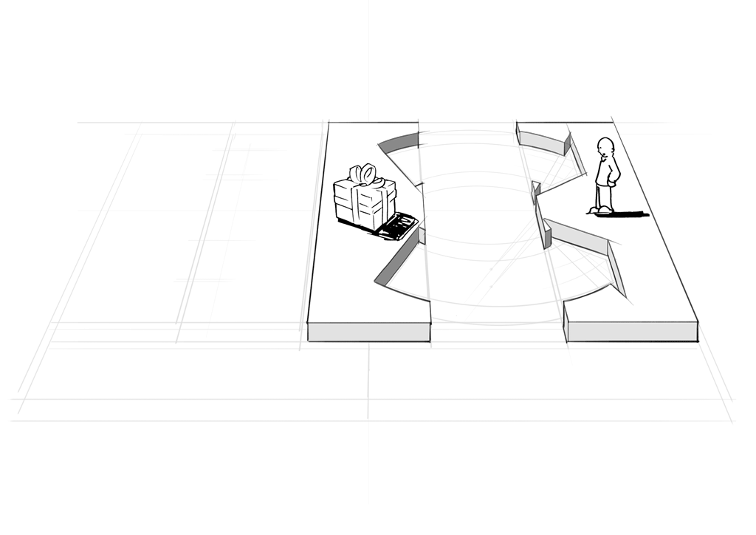
VALUE PROPOSITIONS
images by JAM

Slide 53
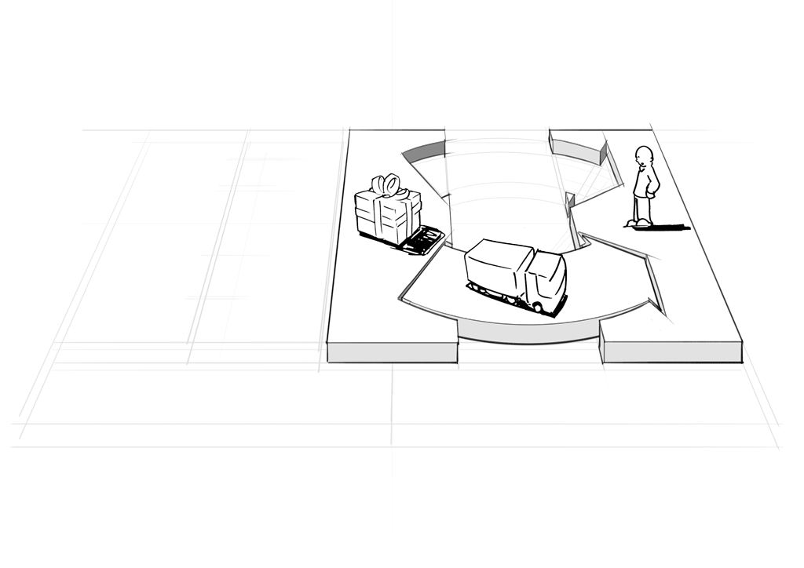
CHANNELS
images by JAM

Slide 54
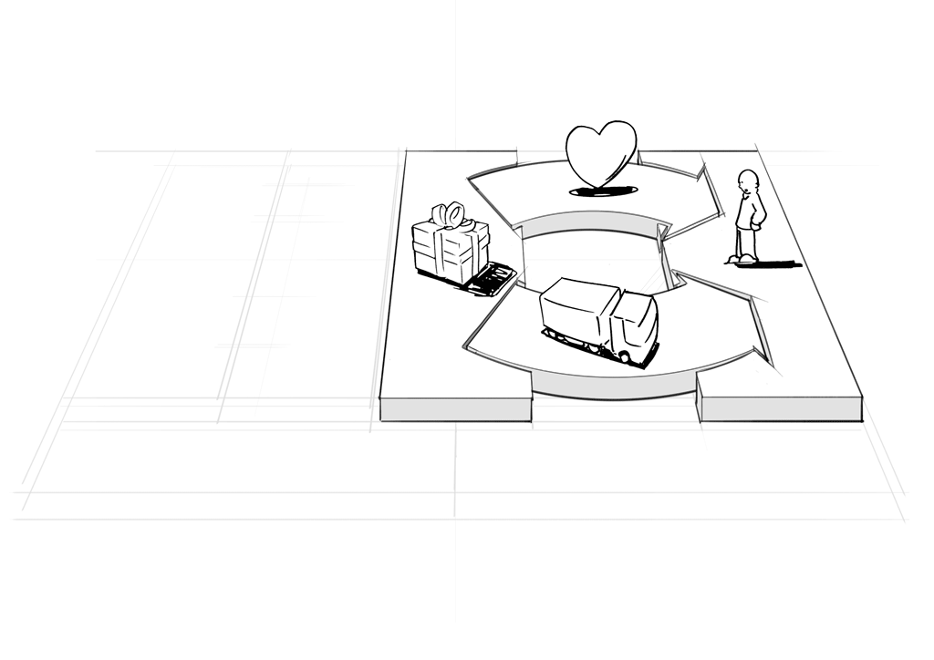
CUSTOMER RELATIONSHIOPS
images by JAM

Slide 55
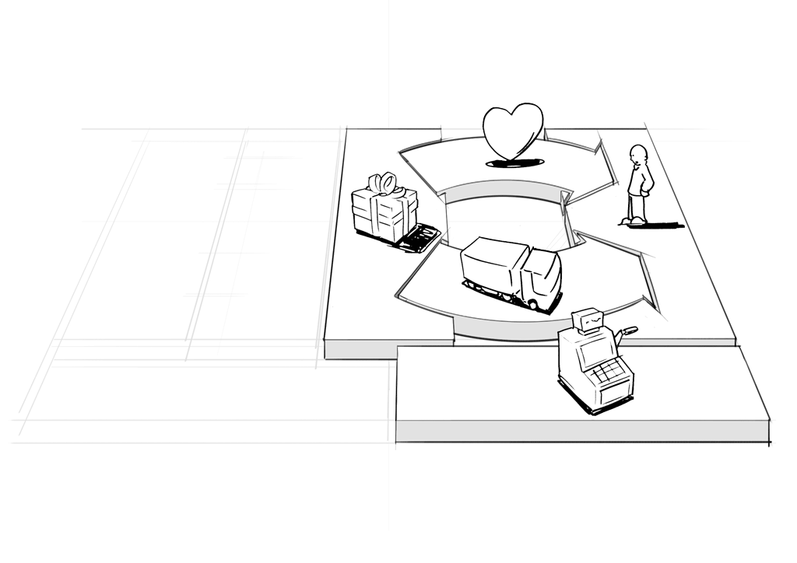
REVENUE STREAMS
images by JAM

Slide 56
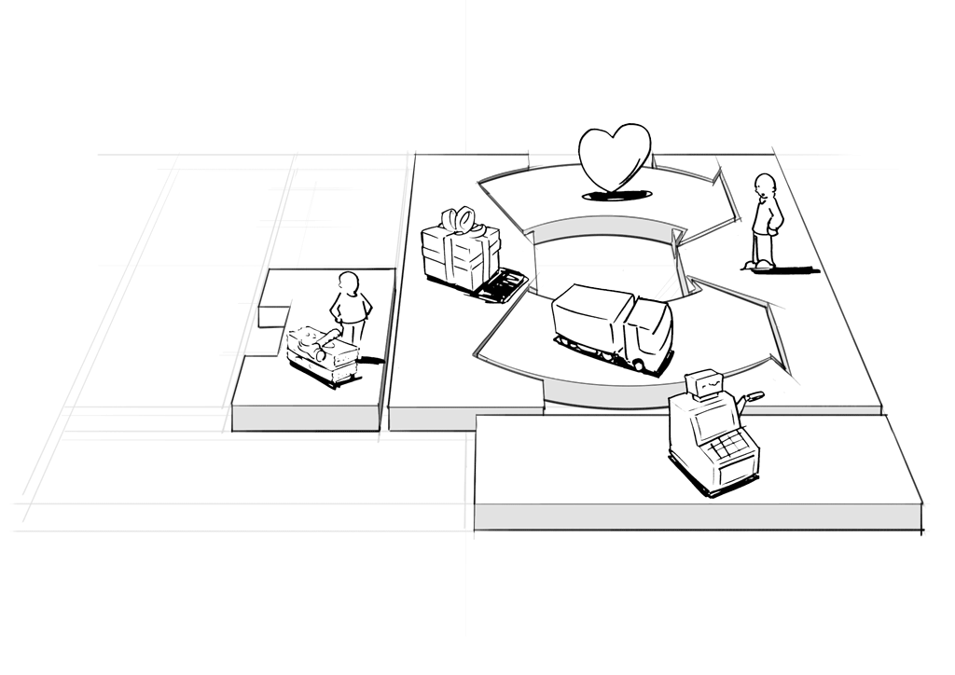
KEY RESOURCES
images by JAM

Slide 57
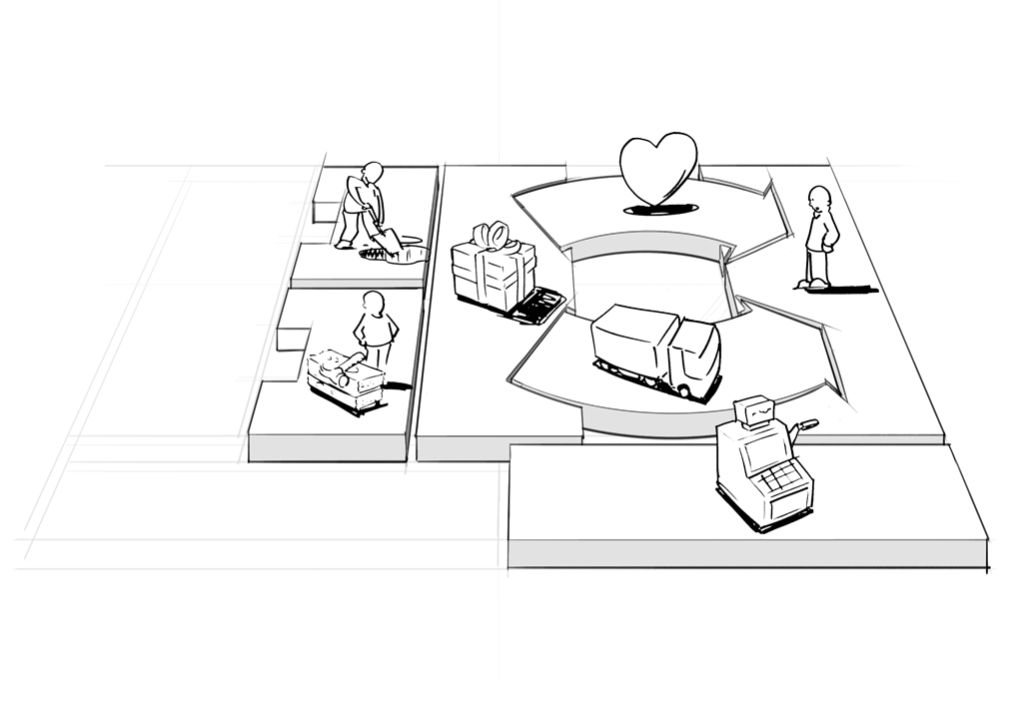
KEY ACTIVITIES
images by JAM

Slide 58
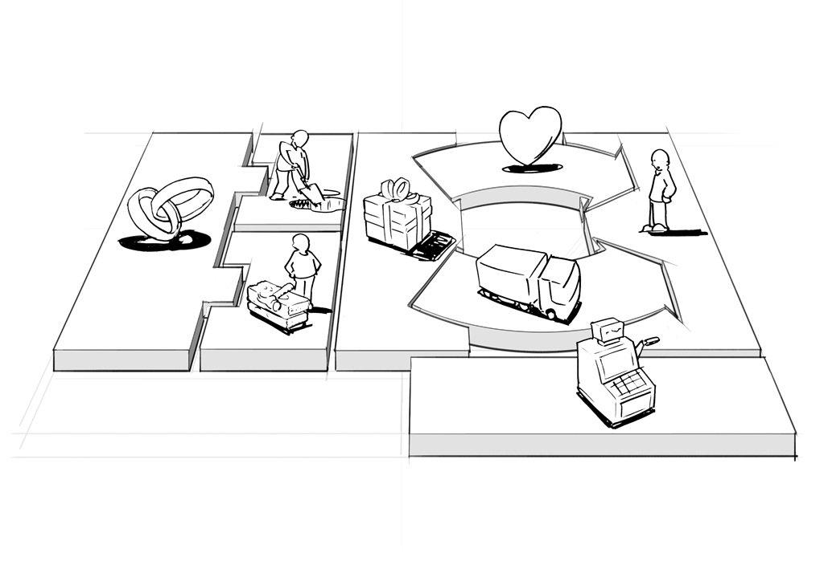
KEY PARTNERS
images by JAM

Slide 59
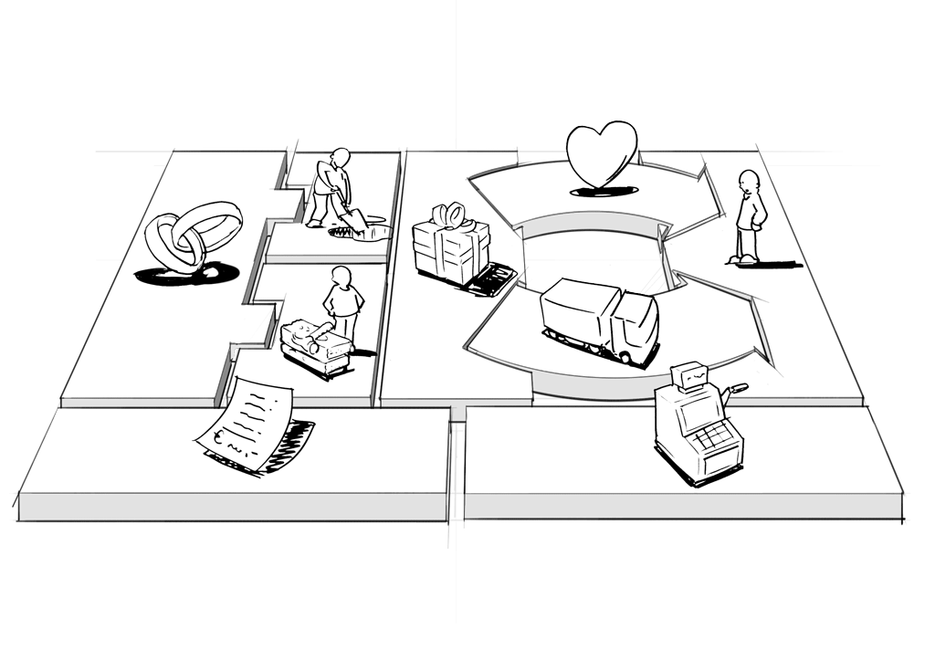
COST STRUCTURE
images by JAM

Slide 60
key activities
value proposition
customer relationships
key partners
customer segments
cost structure
revenue streams
key resources
distribution channels
images by JAM

Slide 61
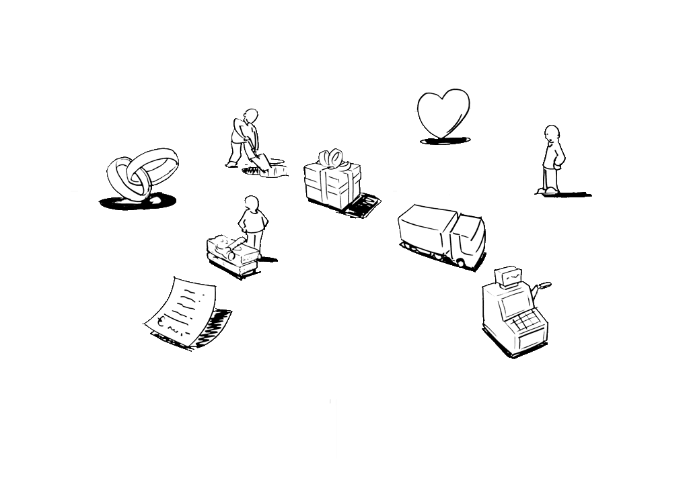
key activities
value proposition
customer relationships
key partners
customer segments
cost structure
revenue streams
key resources
distribution channels
images by JAM

Slide 62
images by JAM

Slide 63
CANVAS OVERLAY
PARTNER
NETWORK
KEY
ACTIVITIES
OFFER
CUSTOMER RELATIONSHIPS
CUSTOMER
SEGMENTS
KEY
RESOURCES
DISTRIBUTION CHANNELS
COST STRUCTURE
REVENUE STREAMS
images by JAM

Slide 64
CANVAS OVERLAY
PARTNER
NETWORK
KEY
ACTIVITIES
OFFER
CUSTOMER RELATIONSHIPS
CUSTOMER
SEGMENTS
KEY
RESOURCES
DISTRIBUTION CHANNELS
COST STRUCTURE
REVENUE STREAMS
images by JAM

Slide 65










THE BUSINESS MODEL CANVAS
PARTNER
NETWORK
KEY
ACTIVITIES
OFFER
CUSTOMER RELATIONSHIPS
CUSTOMER
SEGMENTS
building block
building block
building block
building block
building block
KEY
RESOURCES
DISTRIBUTION CHANNELS
building block
building block
building block
COST STRUCTURE
REVENUE STREAMS
building block
building block
building block

Slide 66
Talking to Customers to Build Your
Business Model

Slide 67
prototyping

Slide 68

Frank Gehry
[source: Sony Pictures]
Notes:
http://z.about.com/d/worldfilm/1/0/j/Z/03.jpg

Slide 69


Slide 70
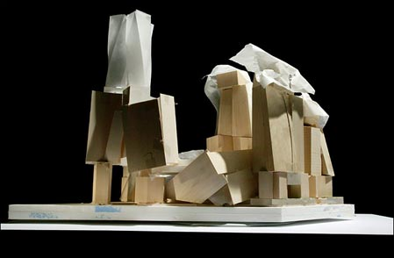

Slide 71
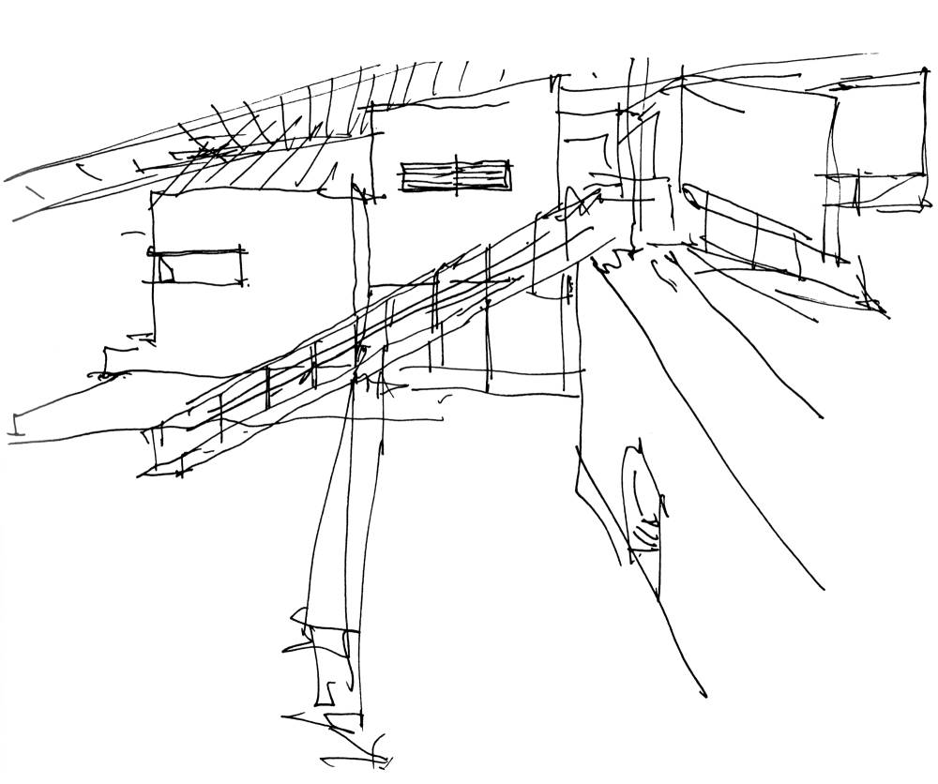
[source: Sony Pictures]
Notes:
http://www.moviesintofilm.com/images/sketches.htm

Slide 72
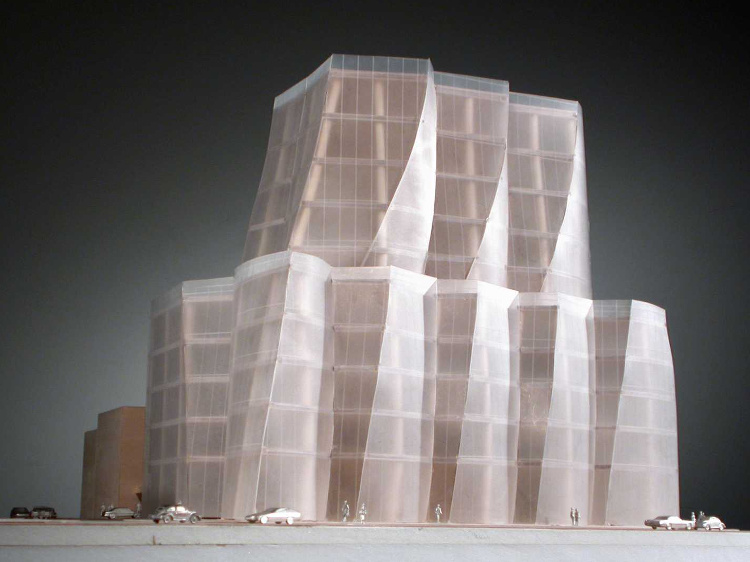
[source: Sony Pictures]
Notes:
http://images.allmoviephoto.com/2006_Sketches_of_Frank_Gehry/2006_sketches_of_frank_gehry_010.jpg

Slide 73
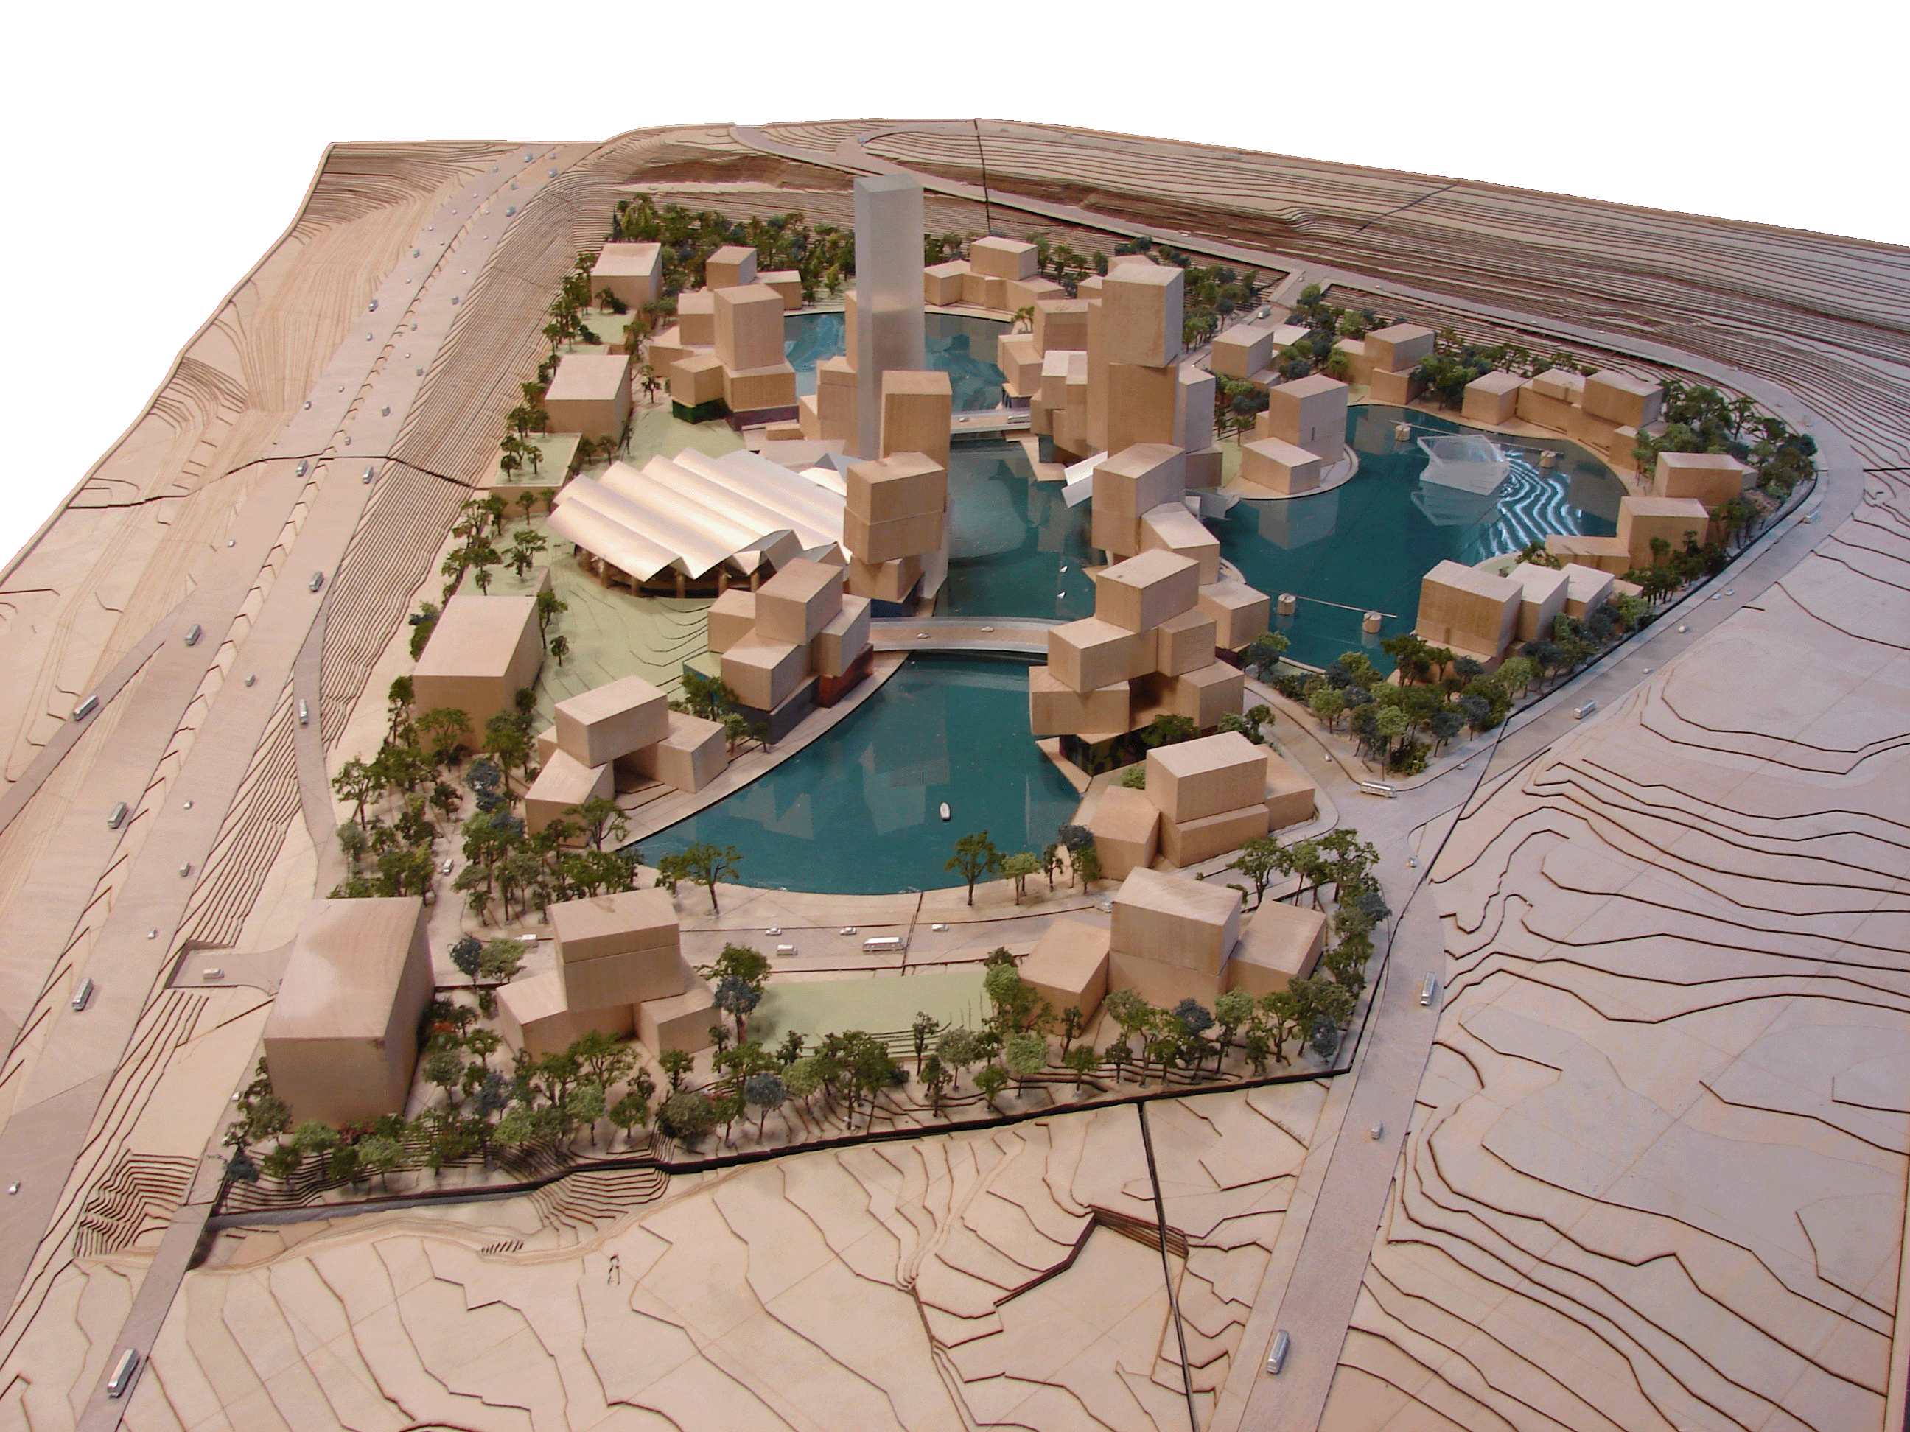
[source: Wikimedia Commons]
Notes:
http://commons.wikimedia.org/wiki/File:Frank_Gehry_Lehi.jpg

Slide 75


Slide 76
?
what does that have to do with business models and my organization?

Slide 78
?
how do we do that?

Slide 79
THE BUSINESS MODEL CANVAS
PARTNER
NETWORK
KEY
ACTIVITIES
OFFER
CUSTOMER RELATIONSHIPS
CUSTOMER
SEGMENTS
building block
building block
building block
building block
building block
KEY
RESOURCES
DISTRIBUTION CHANNELS
building block
building block
building block
COST STRUCTURE
REVENUE STREAMS
building block
building block
building block

Slide 80
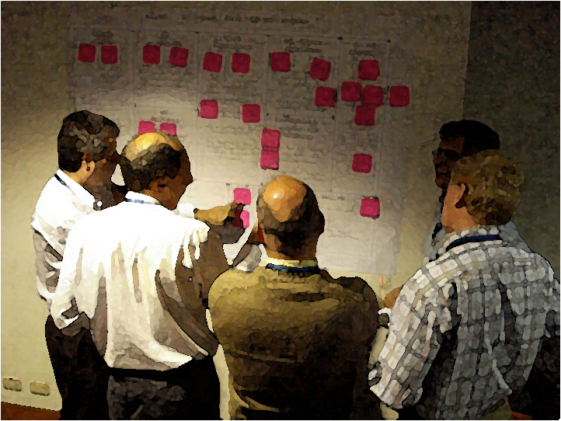

Slide 82
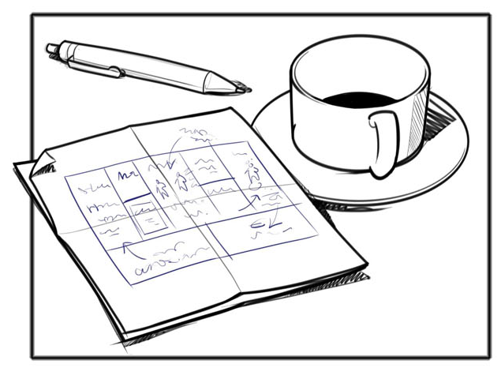
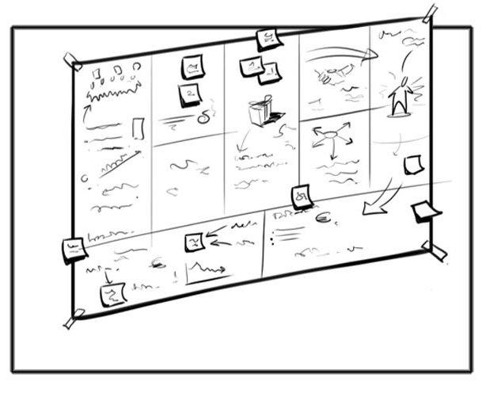
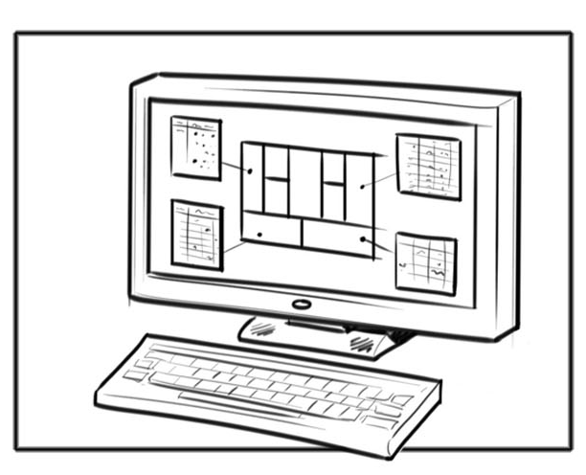
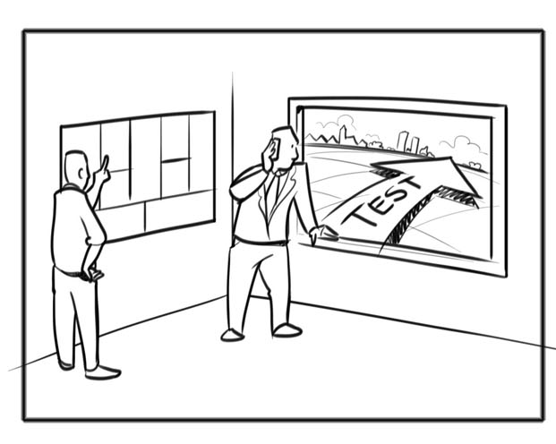
business model prototyping
napkin sketch
Canvas
business case
field test

Slide 83
analyze from the customer perspective
PARTNER
NETWORK
KEY
ACTIVITIES
OFFER
CUSTOMER RELATIONSHIPS
CUSTOMER
SEGMENTS
KEY
RESOURCES
DISTRIBUTION CHANNELS
COST STRUCTURE
REVENUE STREAMS

Slide 84
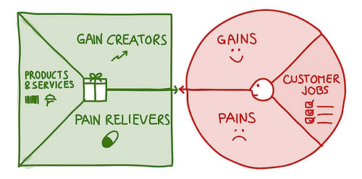
Value Proposition Designer
http://www.businessmodelalchemist.com/2012/08/achieve-product-market-fit-with-our-brand-new-value-proposition-designer.html

Slide 85
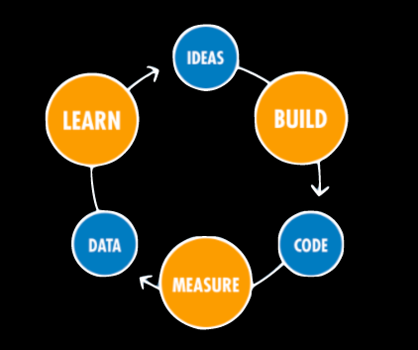
The Lean Start-up Loop
Source: http://www.ashmaurya.com/2010/08/businessmodelcanvas/

Slide 86
Make Small Bets, not Big Ones
The truth is, most entrepreneurs launch their companies without a brilliant idea, and proceed to discover one, or if they do start with what they think is a superb idea, they quickly discover that it’s flawed and then rapidly adapt.
Peter Sims, Little Bets

Slide 87
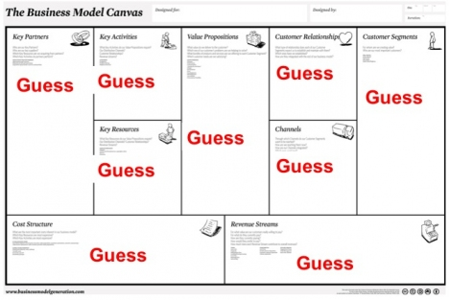
Business Model Testing
Source: http://steveblank.com/2010/10/25/entrepreneurship-as-a-science-%E2%80%93-the-business-modelcustomer-development-stack/

Slide 88
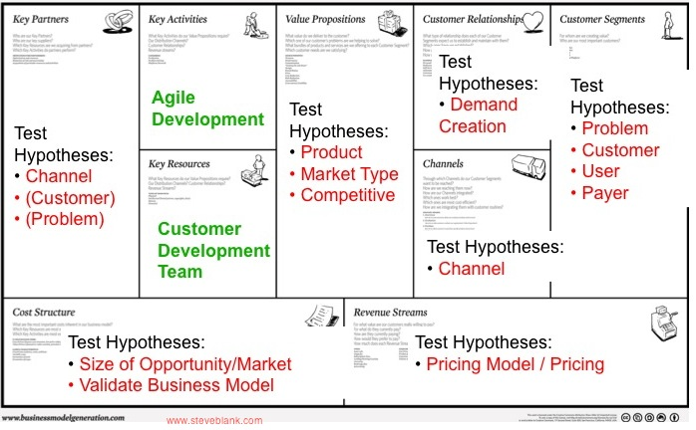
Business Model as a Set of Hypotheses

Slide 89
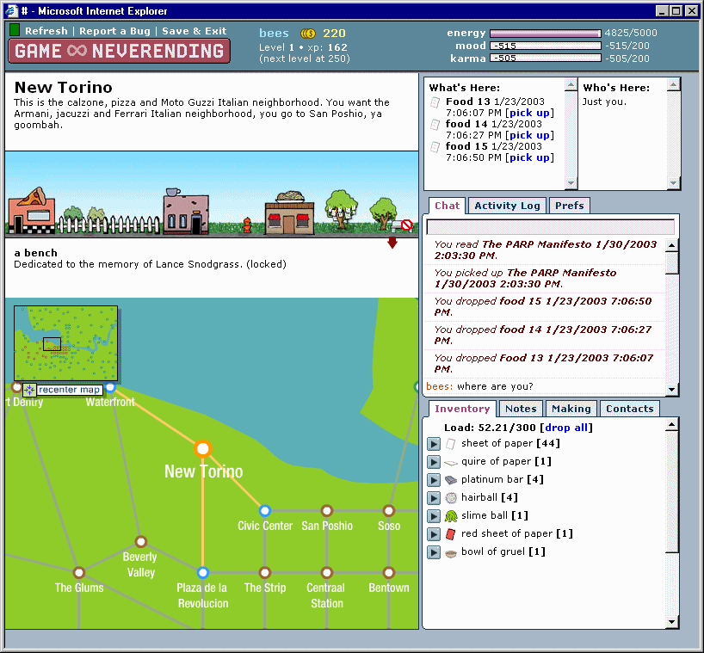

Slide 90
Pivot
The online social game Game Neverending had 30,000 users & was losing tons of money
The designers build backend capability to share files – docs, pdfs, photos etc.
One part of the game took off…

Slide 91

Learn more: http://www.adaptivepath.com/ideas/mxsf-2007-interview-with-caterina-fake

Slide 92
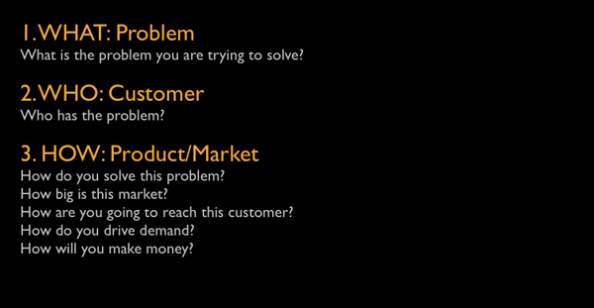
Experimental Business Model Development
Source: http://www.ashmaurya.com/2010/08/businessmodelcanvas/

Slide 93
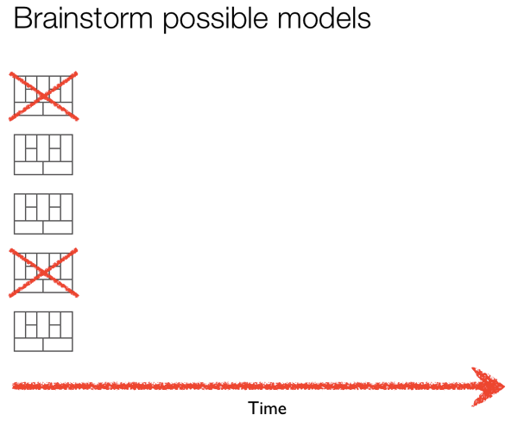
Source: http://www.ashmaurya.com/2011/06/your-product-is-not-the-product/

Slide 94
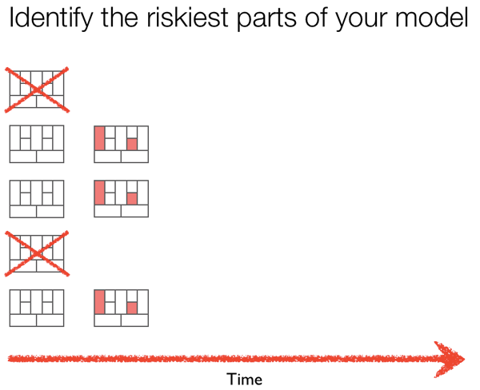

Slide 95
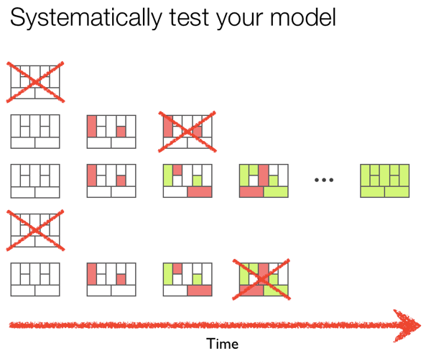

Slide 96
Summary
Make small bets – failing at the level of ideas increases your chances of overall success.
This is only true if you learn from the failures.
Business model experiments are the best way to test your ideas & reduce risk

Slide 97
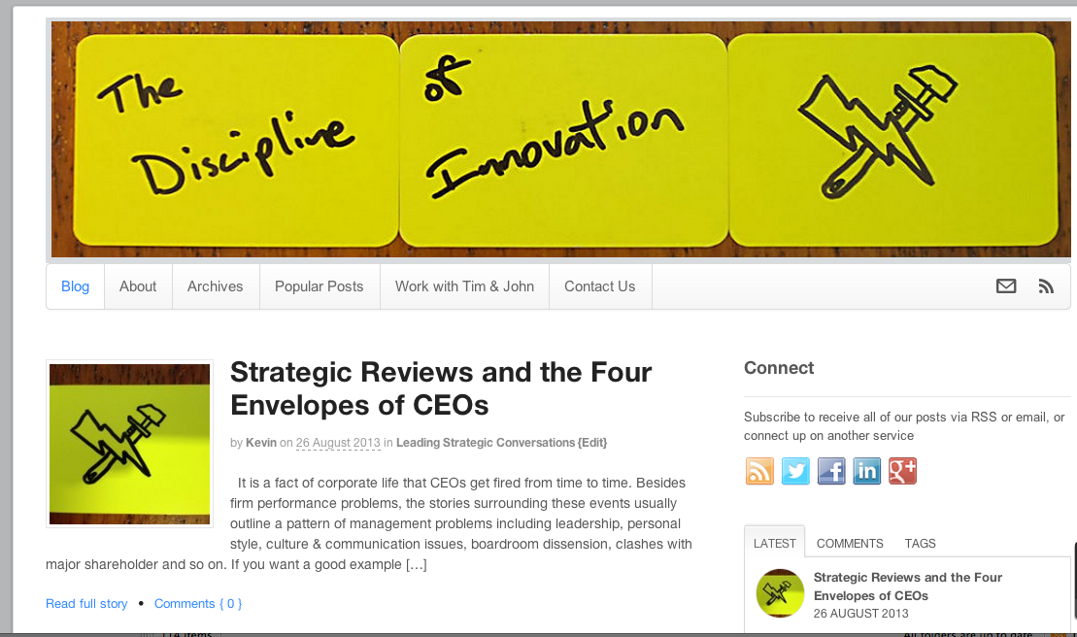
Thank you!
timkastelle.org/theblog/

